Slide 1
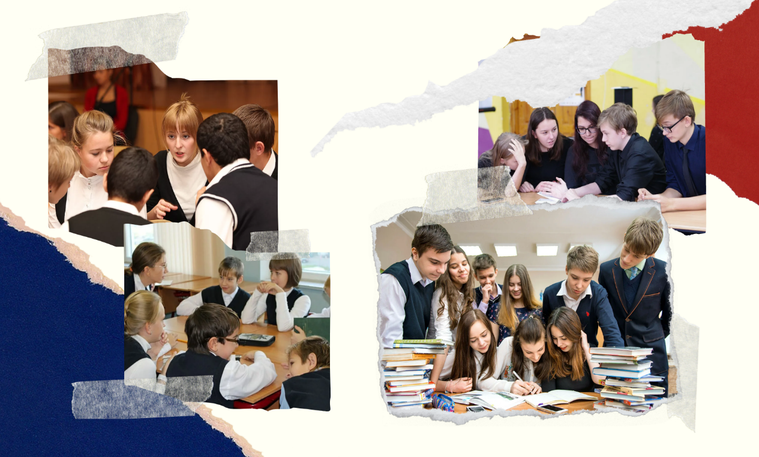
ИНТЕРАКТИВНЫЕ ПРИЕМЫ ФОРМИРОВАНИЯ ИНОЯЗЫЧНОЙ КОММУНИКАТИВНОЙ КОМПЕТЕНЦИИ УЧАЩИХСЯ НА УРОКАХ ИНОСТРАННОГО ЯЗЫКА
Тимохова О.Л.,
учитель английского языка
МБОУ «Лицей № 89» г. Кемерово

Slide 2
How often do you take part in the competitions? | Never | Rarely | Sometimes | Often
To participate in the competitions is a waste of time | Disagree strongly | Disagree somewhat | Do not agree or disagree | Agree somewhat | Agree strongly
Would you like to test your English | Yes | No | Don’t know

Slide 3
Priorities
responsible
industrious
curious
serious
creative
helpful
friendly
energetic
sociable
hospitable

Slide 4
Finish these sentences and make up a story about yourself
I respect people who
I enjoy music which
I couldn’t live without
My lucky number is
I think everybody should
The last time I laughed a lot was
I get bored when
I like to wear
If I had time and money I would

Slide 5
Make up a story about your partner using these questions
Do you always smile and say hello when you meet someone?
Do you get angry very often?
Do you hate spending money?
Do you like to bring friends little presents?
Are you afraid to speak to people you don’t know?
Are you happy to speak to strangers?
Do you always do your homework and spend extra time on schoolwork?
Do you dislike working hard?
Do you seldom boast or say that you are the best?
Are you only interested in yourself?

Slide 6
Learn more about yourself
1. Do you always tell the truth?
2. Do you rarely get upset if things go wrong?
3. Are you obedient to parents, teachers?
4. Are you considerate to your neighbours? Do you respect their rules?
5. Do you obey traffic signals when no one else is around?
6. Do you always keep your word?
7. Do you like number 13?
8. Do you wait your turn in a line?
9. Do you want to make your home and yard tidy?
10. Do you support your friend when he is in a difficult situation?

Slide 7
Positive expectations _______________________________ _______________________________ _______________________________ _______________________________ _______________________________ _______________________________
Negative expectations _______________________________ _______________________________ _______________________________ _______________________________ _______________________________ _______________________________

Slide 8
Всемирный конкурс подростков
Цели урока: образовательная – развитие коммуникативных умений учащихся, обобщение их знаний о конкурсах подростков;
развивающая – развитие критического мышления учащихся, их мотивационно-эмоциональной сферы и внимания;
воспитательная – создание условий для формирования ценностных ориентаций учащихся, патриотизма как личностного качества, развитие социальной ответственности, привитие чувства гордости за лицей, город и область.

Slide 9
Задачи урока
1) Сформировать представление о конкурсном движении.
2) Активизировать лексику по изученной теме в практике её употребления.
3) Совершенствовать умения учащихся в отборе содержания, структурировании и изложении высказываний на определённую тему.
4) Способствовать развитию самооценки учащихся и их личностных качеств.

Slide 10
Composition “A story about myself”
I think I am a reliable person. I always support my friends and value our friendship. I never let my friends down and I am sure I can trust them completely.
It is natural that new things attract me, and I want to learn something new. I enjoy making things. My parents and my friends say that I am a creative person.
I hope I am a flexible person, but I never change my plans at the last moment. I am quite responsible and confident. I don’t lose self – confidence when I have to solve a difficult problem. I try to do my best to find a solution to the problem.
I am a hardworking person, I always do my homework and I am good at all subjects. I also go to music school and practise my piano lessons every day. I always help my parents around the house.
It is difficult to say what I would like to change in myself. Perhaps I am sometimes shy, so I would like to be more confident and easy-going.

Slide 11
The future of our planet
Two friends are chatting one afternoon in a café…
Roma: Have you seen this month’s issue of Green World?
Sasha: No. Is there anything interesting in it?
Roma: Yes, lots of interesting articles as usual. There is one about global warming. The polar ice caps will start to melt and some countries will disappear from our planet. By the way, there are many other awful predictions. I think our nearest future could be a dangerous time.
Sasha: Oh, take it easy. As for me, I am sure that things will not go wrong. People are so clever. They will solve all the problems.
Roma: How can you say that? The trouble is that people do not care about the future. They only pollute our beautiful planet. The seas are in danger. They are filled with poison. When I went to the seaside last summer, I was surprised that the water was not blue, but brown with rubbish floating in it.
Sasha: On the contrary. As far as I know, people begin to realize that pollution is a community problem. That is why they make different organizations, for example, «Green Peace», «Friends of the earth» and others. They do much to protect the environment.
Roma: Do you want to say that they can take measures against global disasters?
Sasha: not everything is so terrible.
Roma: You are kidding. We drink dirty water, acid rains kill wildlife in lakes, rivers and forests, there is a lot of harmful radiation because of growing ozone holes. We can only imagine how many seabirds and animals will die out.

Slide 12
Sasha: Do not rack your brains. Be more optimistic. Scientists will change people’s life. Just think about the progress in different areas: medicine, electronic technologies and space discoveries.
Roma: I must disappoint you. I do not believe that scientists will find cures for AIDS and cancer. I am afraid of new serious diseases. I cannot imagine that computers will control our homes, the walls will be movable and people will live on the moon. It is a fairy-tale.
Sasha: That does not sound too improbable. I will be happy if robots do all the housework.
Roma: Really? Here goes. What about aliens, these green silly monsters?
Sasha: I am afraid you are wrong. They are not silly. They are smarter that you. Aliens will help us to transform our planet into an exotic and colourful place.
Roma: Stop it. That is enough for me. I believe that we must make our future better ourselves.
Sasha: Let us go and join «Green Peace» then. We will help people to keep the earth clean and tidy.
Roma: It is a good idea. We can take a broom and sweep our street just now.

Slide 13
Адрес: г. Кемерово,
ул. Ю. Смирнова, 18А
Телефон: 8(3842)64-15-64
Адрес электронной почты: licey89@yandex.ru
Сайт: licey89.ru

